Slide 1
Immunity Cells and Immune Response
HCS 2100
SLO: 2.9, 3.0-3.5

Slide 2
Reticuloendothelial System
Consists of related cells responsible for the destruction of worn out blood cells, bacteria, cancer cells and other foreign substances that are potentially harmful
Included in this system are monocytes, relatively large white blood cells that are formed in the bone marrow and then circulate in the bloodstream to various areas
Once these monocytes enter into tissues they develop into macrophages “big eaters”

Slide 3
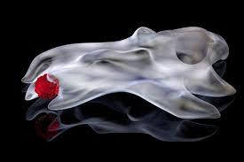
Macrophages
Macrophages in some organs are given special names
Kupffer cells for example, are located in the lining of the liver blood channels
Dust cells are found in the lungs and ingest solid particles that enter the lungs
Others are fond in soft connective tissues all over the body

Slide 4
Antigens
An antigen is any foreign substance that enters the body and induces an immune response
The word is formed from antibody + gen because an antigen stimulates antibody production
Antigens may be found on the surface of pathogenic organisms, on the surface of red blood cells and tissue cells, on pollens, in toxins and in foods
Antigens stimulate certain lymphocytes classified as T or B cells

Slide 5
T-Cells
Both T and B cells come from stem cells in bone marrow
80% of these immature stem cells migrate to the thymus and become T-cells
There are several types of T-cells

Slide 6
Cytotoxic T cells
Also known as killer T cells
Destroy foreign cells directly
Helper T cells
Release substances known as interleukins that stimulate other lymphocytes and macrophages and thereby assist in the destruction of foreign cells

Slide 7
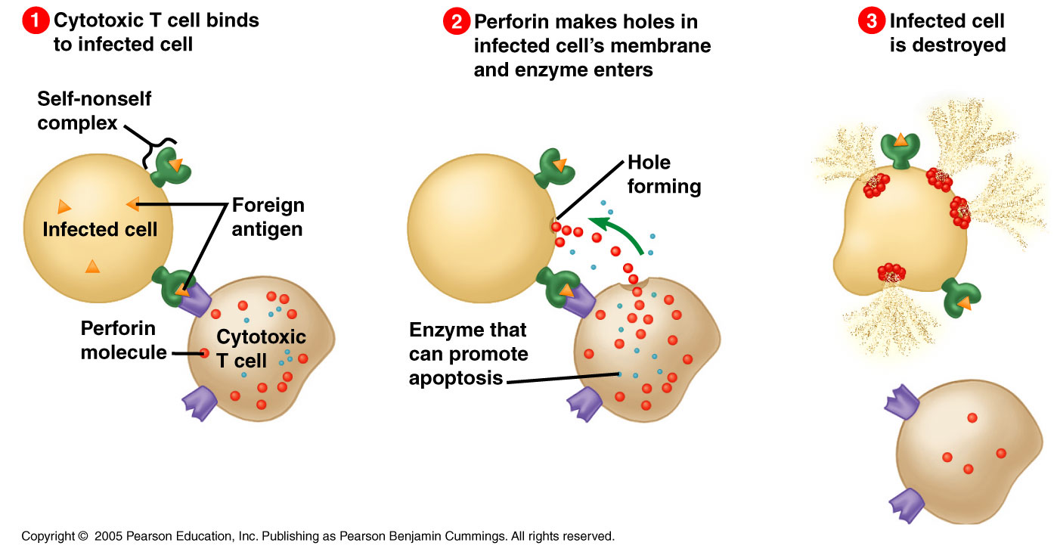

Slide 8
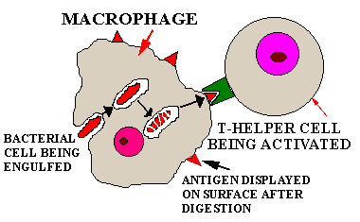
Look at the bottom of pg 369 in your 11th Edition textbook Figure 17-2 for a description of the activation of a helper T cell by a macrophage

Slide 9
Role of Macrophages
They ingest foreign proteins, such as disease organisms and break them down within phagocytic vesicles
They then insert fragments of the foreign antigen into their plasma and display them on the macrophage’s surface in combination with antigens that a T cell can recognize as belonging to the “self”
Self-antigens are known as MHC (major histocompatibility complex) antigens
Macrophages and other cells that present antigens to T cells are known as APCs (antigen presenting cells)

Slide 10
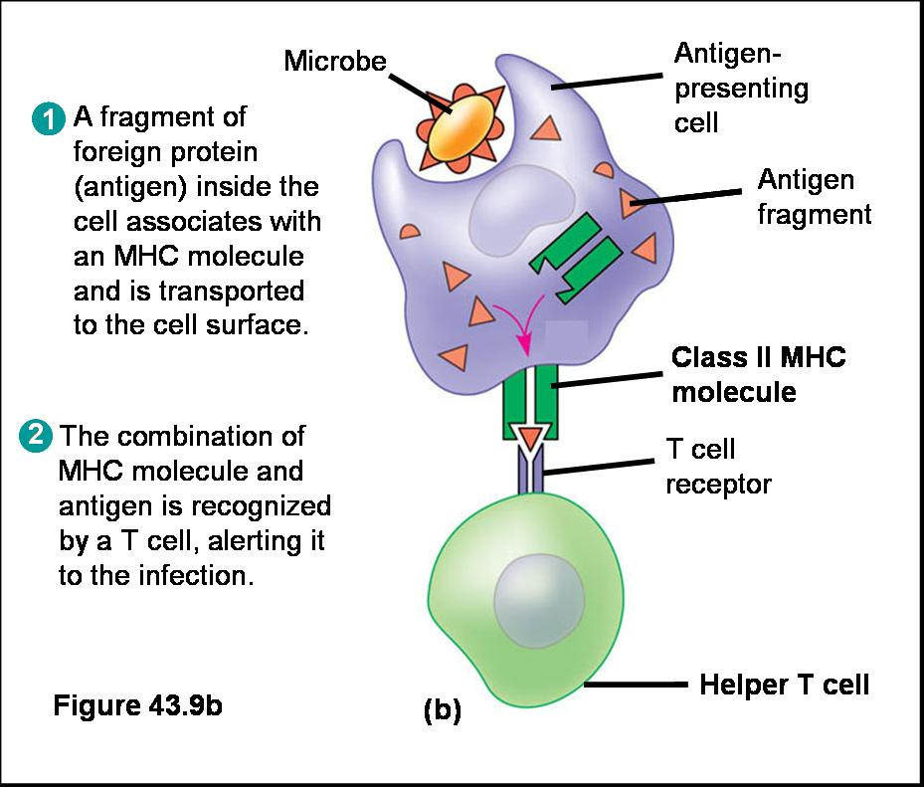

Slide 11
For a T cell to react with a foreign antigen, that antigen must be presented to the T cell along with the MHC proteins
A special receptor on the T cell must bind with both the MHC protein and the foreign antigen fragment
The activated Helper T cell (Th) then produces interleukins which stimulate other leukocytes like B cells
See figure 17-2 on pg 369 again

Slide 12
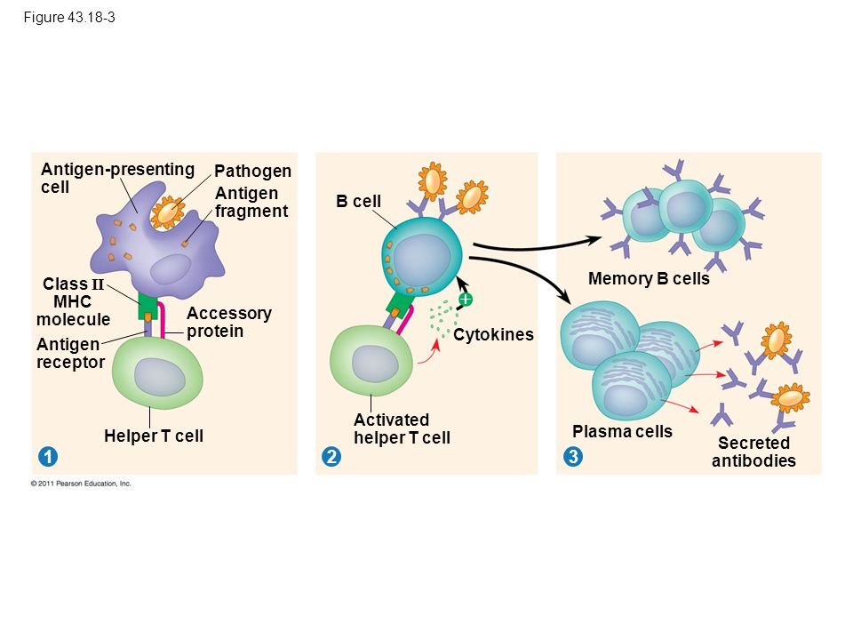

Slide 13
Video:
https://www.youtube.com/watch?v=rd2cf5hValM

Slide 14
B Cells and Antibodies
Antibodies are manufactured by B cells
B cells have surface receptors that bind with a specific type of antigen
Exposure to the antigen stimulates the cells to multiply rapidly and produce large numbers of plasma cells. These mature cells produce antibodies against the original antigen and release them into the blood * See figure 17-3 pg. 370

Slide 15
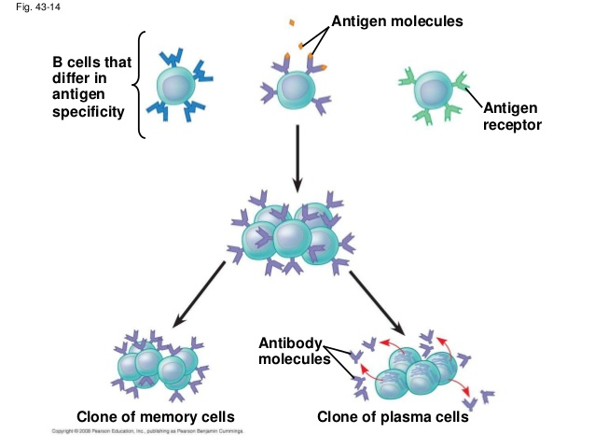

Slide 16
Memory T cells and Regulatory T cells
Memory T cells remember an antigen and start a rapid response if that antigen is contacted again
Regulatory T cells (suppressor T cells) suppress the immune response in order to prevent over activity. These T cells may inhibit or destroy active lymphocytes

